Slide 1

Usage Funnels with Warby Parker
Learn SQL from Scratch
Kyle Willingham
05/13/2019

Slide 2
Table of Contents
1. Quiz Funnel
2. A/B Testing with Home Try-On Funnel
3. Conversion Totals
4. Discovery
5. Actionable Insight

Slide 3
1. Quiz Funnel

Slide 4
1.1 Quiz Funnel
The table below represents the data taken from Warby Parker’s survey table that was offered to users.
The last question (“When was your last eye exam?”) had the lowest completion rate of the survey.
The third question (“ Which shapes do you like?”) had the second lowest completion rate. This may be due to users being indecisive on shape because they are not able to try them on and know for certain.
Questions | Number of Responses | Completion Rate
What are you looking for? | 500 | 100%
What’s your fit? | 475 | 95%
Which shapes do you like? | 380 | 80%
Which colors do you like? | 361 | 95%
When was your last eye exam? | 270 | 75%
Survey Table Database Schema
Question
User_id
Response

Slide 5
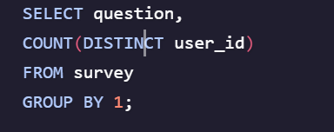
1.2 What is the Quiz Funnel?
What are you looking for?
100%
What’s your fit?
Possible reasons for the last question having the lowest completion rate:
95%
Most users think the first four questions are basic and easy to answer quickly.
Users can not remember their last eye appointment
Users just want to get past the survey
Some users may not think it is relevant to their visit
Which shapes do you like?
80%
Which colors do you like?
95%
When was your last eye
exam?
Question
75%
Completion Rate

Slide 6
2. A/B Testing with Home Try-on Funnel

Slide 7
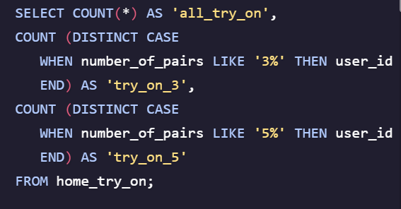
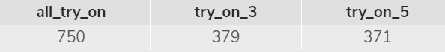
2.1 A/B Testing with Home Try-On Funnel
Home Try On 3 Pairs | Home Try On 5 Pairs
379 | 371
The table on the right represents the number of users who tried on 3 pairs vs. 5 pairs at home before making a decision to purchase.
There was a total of 750 users that received pairs of eyewear to try-on at home.
379 users received 3 pairs each, while 371 users received 5 pairs each, making the A/B test split fairly down the middle 50/50.

Slide 8
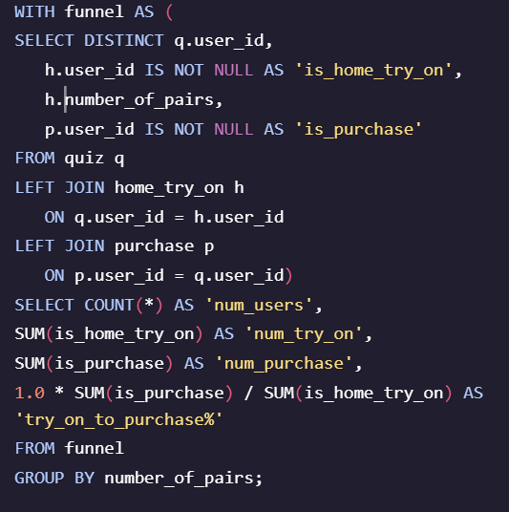
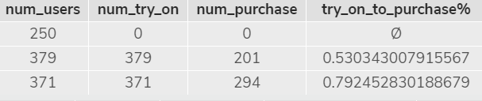
2.2 A/B Testing with Home Try-On Funnel
750 Users received try-on pairs
750 Users received try-on pairs
379 Users received 3 pairs each
371 Users received 5 pairs each
201 Users made a purchase
294 Users made a purchase
53%
79%
Purchased after trying 3 pairs
Purchased after trying 5 pairs

Slide 9
3. Conversion Totals

Slide 10
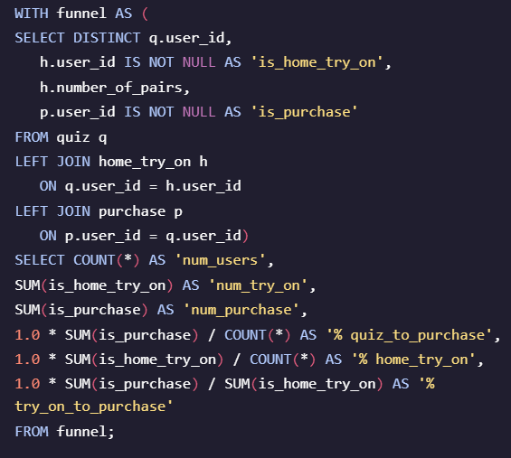

3.1 Conversion Totals
1000 users took the quiz
750 users signed up for the home try-on trial
495 home try-on users ended up making a purchase
75% conversion from taking the quiz to trying on at home
49.5% conversion from quiz to purchase
66% conversion from home try-on to purchase

Slide 11
4. Discovery

Slide 12
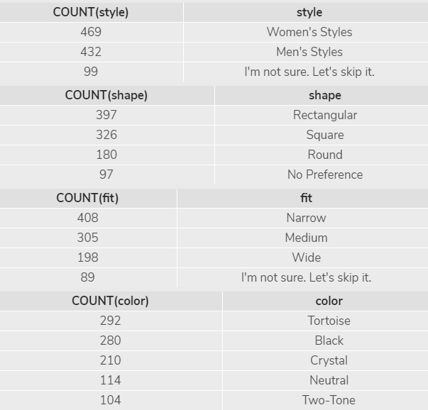
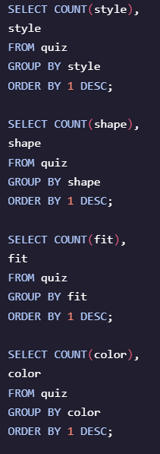
4.1 Discovery (Style Quiz)
The tables on the right represent some basic insights into the style quiz that users took.
Out of the 1000 users that took the quiz:
99 were not sure what style they preferred (almost 10%).
97 users did not have a preference on shape (almost 10%).
89 users were not sure about what fit they preferred (about 9%).
Tortoise was the top color with 292 users choosing that color on the quiz.
The majority of users preferred women’s style eyewear (469 users).

Slide 13
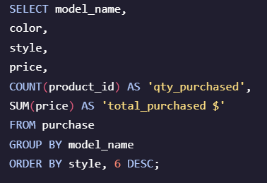
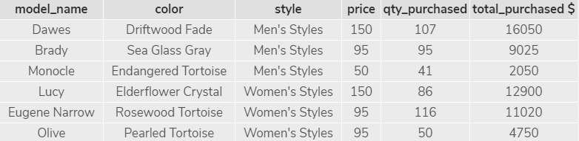
4.2 Discovery (Purchases)
The table below represents what was purchased by users
Top men’s style sold in both quantity and dollars was the Dawes, color Driftwood Fade. 107 pairs / $16,050 sold
Top women’s style sold in quantity was the Eugene Narrow, color Rosewood Tortoise. 116 pairs sold
Top women’s style sold in dollars was the Lucy, color Elderflower Crystal. $12,900 sold
243 men’s styles were purchased(49.1%) and 252 women’s styles were purchased(50.9%) making sales evenly distributed between genders.

Slide 14
5. Actionable Insight

Slide 15
5.1 Actionable Insight
The last question on the survey should be changed or taken out all together with having the lowest completion rate. It would shorten the survey and yield higher overall completion rates as a whole.
A couple possible questions to ask in the survey: 1) is the user looking for eyewear for themselves or as a gift? 2) is the user male or female? This may help to distinguish what gender the majority of the users visiting and making purchases are. You can not conclude this based off of what was purchased as we do not know if a user was buying for themselves or someone else.
With the number of people who converted to purchasing eyewear after trying on 5 pairs vs. 3 pairs at home (79% vs. 53%), I would be in favor of pushing the try-on 5 pairs to help increase sales conversion rate.
There should be a way of getting/recording feedback from the people who participated in the home try-on to see what products are hot or not and why.
The most popular eyewear purchased (in dollars) were the most expensive of the group for men’s and women’s styles. There is no data on inventory or cost of goods sold, but one could conclude that if the price was discounted a little then sales may increase in pairs sold and dollars sold.
There could be some targeted emails to the 250 users that took the quiz but opted out of the home try-on to incentivize them to sign-up for the home try-on to help improve conversion rates.

